Slide 1
電気回路演習I Series and Parallel Circuit
水戸 慎一郎

Slide 2
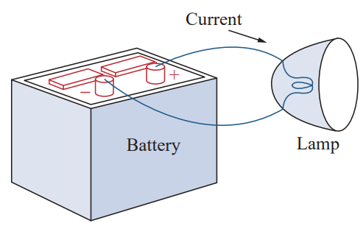
Electric Circuit: Today’s Focus
Why Circuits Work | Key Elements | What We’ll Compare
A Closed path lets electric charge flow. | Source: battery Conductors: wires Load: lamp | Series connections Parallel connections

Slide 3
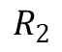
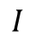
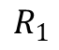
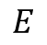
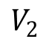
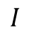
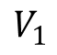
Series Resistors
Resistors are in series when they are connected one after another in a single path. The output end of one resistor touches the input end of the next.
The same current flows through every resistor because there is only one route for the charges.
The battery’s voltage is shared (divided) across the resistors. Each one gets a part of the total voltage.
The same current passes through every resistor, but the total voltage is divided across them.
$$I$$
$$I$$
Water Circulation
water level: High
$$R_{1}$$
$$V_{1}$$
$$E$$
loop 1
$$R_{2}$$
$$V_{2}$$
Two resistors in series
Pump
Applying Ohm’s law to each resistor: $V_{1}=IR_{1}$, $V_{2}=IR_{2}$
Then, Applying Kirchhoff’s voltage law for loop: ${E=V}_{1}+V_{2}=I\left(R_{1}+R_{2}\right)$
So, we can define the total resistance $R$ by$R=R_{1}+R_{2}$
water level: Low

Slide 4
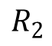
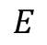
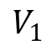
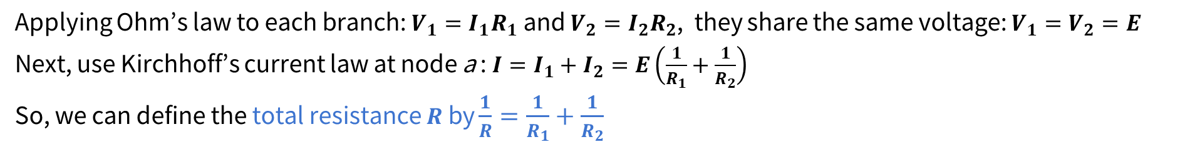
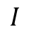
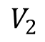
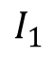
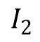
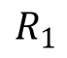
Parallel Resistors
Resistors are in parallel when their ends are tied to the same two nodes. Each resistor has its own branch, so there is more than one path for the charges.
Every branch sees the same voltage because both ends of each resistor touch the same pair of points.
The current splits up across the branches. The sum of the branch currents equals the total current from the source.
a
The current splits between the resistors, but each resistor has the same voltage across it.
Water Circulation
$$I$$
$$I_{1}$$
$$I_{2}$$
$$E$$
$$R_{1}$$
$$R_{2}$$
$$V_{1}$$
$$V_{2}$$
Pump
Two resistors in parallel
Applying Ohm’s law to each branch: $V_{1}=I_{1}R_{1}$ and $V_{2}={I_{2}R}_{2}$, they share the same voltage: $V_{1}=V_{2}=E$
Next, use Kirchhoff’s current law at node a : ${I=I}_{1}+I_{2}=E\left(\frac{1}{R_{1}}+\frac{1}{R_{2}}\right)$
So, we can define the total resistance $R$ by $\frac{1}{R}=\frac{1}{R_{1}}+\frac{1}{R_{2}}$

Slide 5
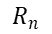
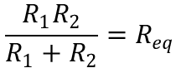
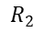
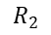
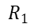
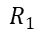
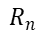
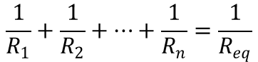
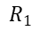
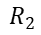
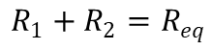
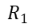
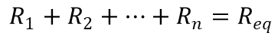
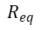
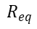
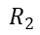
Equivalent Resistance (Total Resistance)
When resistors are connected in series, their equivalent resistance is simply the sum of their individual resistances.
When resistors are connected in parallel, the reciprocal of their equivalent resistance equals the sum of the reciprocals of their individual resistances.
For the special case of two parallel resistors, that rule can be rearranged into the “product over sum” shortcut.
$$R_{1}$$
$$R_{eq}$$
$$R_{1}$$
$$R_{2}$$
$$⋯$$
$$R_{n}$$
$$R_{eq}$$
$$R_{1}$$
$$R_{2}$$
$$R_{1}$$
$$R_{2}$$
$$R_{eq}$$
$$R_{eq}$$
$$n$$
$$R_{2}$$
$$R_{1}+R_{2}+…+R_{n}=R_{eq}$$
$$n$$
$$\frac{R_{1}R_{2}}{R_{1}+R_{2}}=R_{eq}$$
$$\frac{1}{R_{1}}+\frac{1}{R_{2}}+⋯+\frac{1}{R_{n}}=\frac{1}{R_{eq}}$$
$$R_{1}+R_{2}=R_{eq}$$
$$R_{n}$$
Equivalent resistance in series
Equivalent resistance in parallel

Slide 6
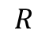
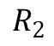
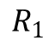
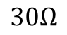
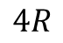
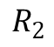
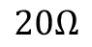
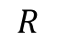
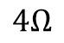
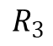
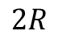
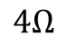
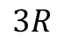
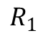
Exercise
Q1. Find the total resistance.
(1)
(2)
(3)
$$20Ω$$
$$30Ω$$
$$4Ω$$
$$4Ω$$
$$R$$
$$3R$$
(4)
(5)
(6)
$$R_{1}$$
$$R_{2}$$
$$R$$
$$2R$$
$$4R$$
$$R_{1}$$
$$R_{2}$$
$$R_{3}$$

Slide 7
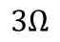
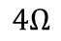
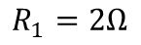




















How to Find $R_{eq}$ in Complex Resistors Network
$$4Ω$$
$$1Ω$$
To find the total resistance of a complex circuit, we combine resistors step by step using series and parallel rules.
$$R_{eq}$$
$$2Ω$$
1) First, calculate $R_{1}$ as the parallel combination of 6 Ω and 3 Ω:
$$5Ω$$
$$4Ω$$
$$1Ω$$
$$8Ω$$
$$6Ω$$
$$3Ω$$
$$R_{1}=\frac{6×3}{6+3}=2Ω$$
$$2Ω$$
$$5Ω$$
$$8Ω$$
$$R_{1}=2Ω$$
Example of complex resistors network
2) Next, add 2 Ω in series with $R_{1}$​ ​to get $R_{2}$​. Also, combine the 1 Ω and 5 Ω resistors in series to get $R_{3}$​.
Now, $R_{2}$​ and $R_{3}$​ are connected in parallel, so the total resistance $R_{4}$ can be calculated using $R_{2}$​and $R_{3}$​:
$$4Ω$$
$$4Ω$$
$$R_{4}=\frac{R_{2}R_{3}}{R_{2}+R_{3}}=2.4Ω$$
$$R_{2}=4Ω$$
$$R_{3}=6Ω$$
$$R_{eq}=14.4Ω$$
$$8Ω$$
$$8Ω$$
$$R_{eq}=4Ω+2.4Ω+8Ω=14.4Ω$$
3) Finally, 4 Ω, $R_{4}$​, and 8 Ω are in series:

Slide 8











Exercise
Q2. Find the total resistance.
(1)
$$20Ω$$
(2)
$$10Ω$$
$$20Ω$$
$$10Ω$$
$$30Ω$$
$$30Ω$$
(3)
(4)
$$20Ω$$
$$10Ω$$
$$20Ω$$
$$10Ω$$
$$30Ω$$
“short-cut”
“opened”

Slide 9













Exercise
Q3. Find the total resistance $R$ and complete a table following when 642 V of voltage is applied across a-b.
$$I_{1}$$
$$I_{3}$$
$$R=$$
$$I=$$
24kΩ | $$I_{1}=$$
 | $$V_{1}=$$
16kΩ | $$I_{2}=$$
 | $$V_{2}=$$
30kΩ | $$I_{3}=$$
 | $$V_{3}=$$
90kΩ | $$I_{4}=$$
 | $$V_{4}=$$
$$R_{1}:24kΩ$$
$$R_{3}:30kΩ$$
a
$$V_{1}$$
$$V_{3}$$
b
$$I_{2}$$
$$I_{4}$$
$$R_{2}:16kΩ$$
$$R_{4}:90kΩ$$
$$V_{2}$$
$$V_{4}$$

Slide 10










Voltage Divider Rule (Series Circuit)
Series circuit (Voltage divider)
Same current $I$ flows through both resistors because they are in series.
By Ohm’s law: $V_{1}=IR_{1},V_{2}=IR_{2}$
Kirchhoff’s voltage law gives: $E=V_{1}+V_{2}$
Eliminate $I$ to get the voltage divider rule:
$$I$$
$$I$$
$$R_{1}$$
$$V_{1}$$
$$E$$
$$V_{1}=IR_{1}=$$
$$R_{2}$$
$$V_{2}$$
$$V_{2}=IR_{2}=$$
Find voltage without current!

Slide 11











Current Divider Rule
Same voltage $E$ on each branch: $V_{1}=V_{2}=E$
Ohm’s law for each resistor: $I_{1}=\frac{E}{R_{1}},I_{2}=\frac{E}{R_{2}}$
Express the supply voltage in terms of the total current $I=I_{1}+I_{2}=E\left(\frac{1}{R_{1}}+\frac{1}{R_{2}}\right)=E\frac{R_{1}+R_{2}}{R_{1}R_{2}} → E=I\frac{R_{1}R_{2}}{R_{1}+R_{2}}$
Substitute $E$ back into the branch currents
Two resistors in parallel
(Current divider)
$$I$$
a
$$I_{2}$$
$$E$$
$$R_{1}$$
$$V_{1}$$
$$R_{2}$$
$$V_{2}$$
$$I_{1}=$$
$$I_{2}=$$
Find branch current without solving for $V$!

Slide 12











Exercise
Q4. For the circuit shown in picture, find...
Total resistance R
Voltage $V_{0}, V_{1},$ and $V_{2}$ by voltage division
Current $I_{1}$and $I_{2}$ by current division
$$V_{0}$$
$$I$$
a
$$4Ω$$
$$I_{1}$$
$$I_{2}$$
$$E=12V$$
$$6Ω$$
$$3Ω$$
$$V_{1}$$
$$V_{2}$$

Slide 13
おまけ Optional Exercise
3つの抵抗$R_{1}=1Ω$、 $R_{2}=2Ω$、 $R_{3}=3Ω$のすべての接続方法に対して、合成抵抗$R_{0}$を求めよ。
Determine the equivalent resistance $R_{0}$ for every possible way of connecting three resistors $R_{1}=1Ω$, $R_{2}=2Ω$, and $R_{3}=3Ω$.
6 Ω
0.545 Ω
2.2 Ω
2.75 Ω
3.67 Ω
0.833 Ω
1.33 Ω
1.5 Ω

